Slide 1
Flight Delay Prediction with
Deep RNN and LSTM architecture
CSE 571: Artificial Intelligence
Group 18
Team Members:
Ruthvik Nakka: 1215134882
Madhu Priyatam PV: 1215125015
Vipanchi Chacham: 1215175351

Slide 2
Problem Statement:
Flight delays cause substantial Economic loss
Solving this makes it optimized, cost-effective and reduces long queues in airports
Solutions have been proposed through few deep learning methods but proved to be inefficient and computationally costlier
Main aim of the project is to predict the delays in the flight system

Slide 3
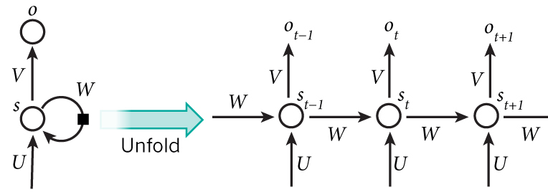
Concepts: Recurrent Neural Networks(RNN)
RNNs Remember.
Neural networks with loops, allowing information to persist
RNN can be thought of as multiple copies of the same network
Each copy of the network at one time step, passing a message to its successor at next time step

Slide 4
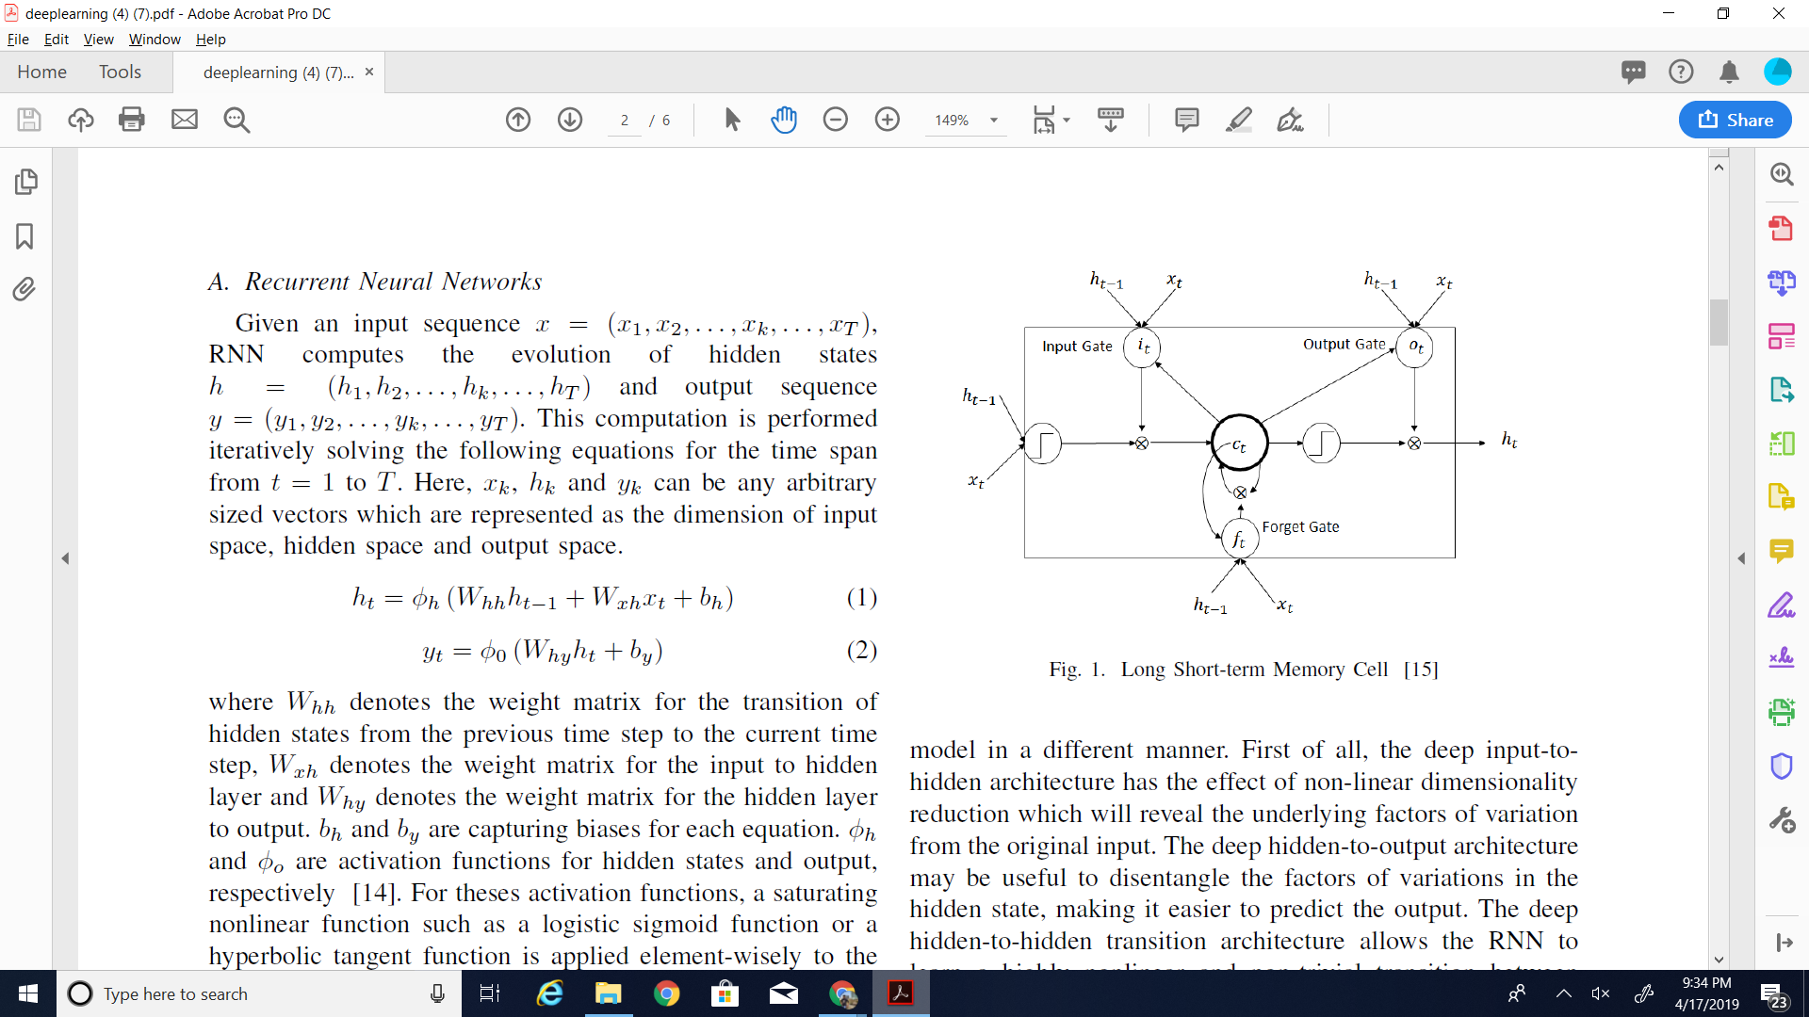
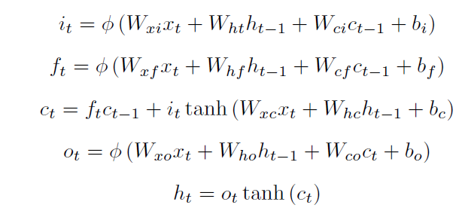
Approach
WEIGHTS DO THE MAGIC!!!
Long Short-Term Memory (LSTM) networks are one kind of implementation of RNN architectures which is faster and more accurate than standard RNNs
The output h_{t} is given as an input to the next layer at the same time step and also utilized by the same layer in the next time step, recurrently.

Slide 5
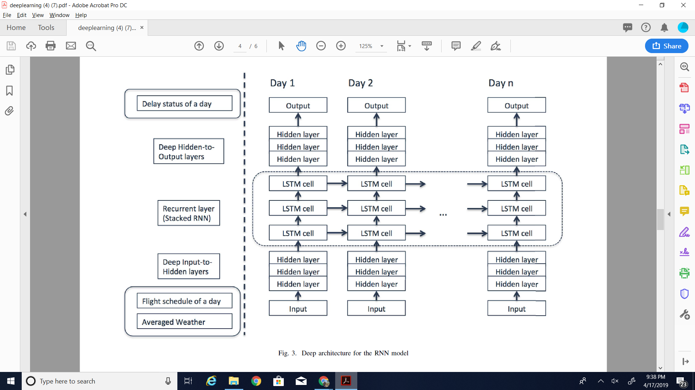
Approach
Deep Architecture of RNN Model
Young Jin Kim, Sun Choi, Simon Briceno, and Dimitri Mavris. A deep learning approach to flight delay prediction. In 2016 IEEE/AIAA 35th Digital Avionics Systems Conference (DASC), pages 1–6. IEEE, 2016.

Slide 6
Results
Trained the network from 2004 year’s flight dataset and tested with 2007 year’s dataset
Our testing varied from 2 to 6 hidden layers and 3 to 10 nodes per hidden layer
At every step, we took 3 LSTM layers with one LSTM cell in each layer
Back propagating through time (BPTT) algorithm is used to learn weights in training
Stochastic Gradient Descent (SGD) method is used to optimize the loss function for every training sample
Our results gave an average accuracy of 48.6%
Dataset used: Bureau of transports statistics, http://www.transtats.bts.gov

Slide 7
Thank you

Slide 8
APPENDIX

Slide 9
Implementation details
This project is an implementation of RNN & LSTM on Flight prediction systems proposed in the research paper: https://ieeexplore.ieee.org/abstract/document/7778092
Used preprocessed dataset and neural network header files from this link to implement RNN with LSTM.
Implemented the equations of the LSTM cell for computation of the model as mentioned in the paper
Steps involved:
Feed Forward of the input.
Minimize the loss function by SGD method
Calculating error at the output layer and back propagating to underlying layers using BPTT
Repeating the above steps for each sample in the given training dataset

Slide 10
Challenges
Neural Networks are essentially a black box, had a hard time in understanding how they converge to an expected result.
Selection of an implementation of BPTT and SGD algorithm from many variants available
Behavior of weights and updating it during back propagation to make it compatible with Hidden and LSTM layers.
Selecting a suitable technique from one of the many weight initialization techniques
Time taken to train model for 50 x 1000 iterations

Slide 11
Individual Contribution
Integrating the LSTM layers into this stack of already implemented ANN: Ruthvik
LSTM cell implementation with proposed model from the paper. (which involved initializations in perceptron) and feed forward implementation: Madhu
Implementing stochastic gradient descent algorithm which is used for training data.(This uses only one random sample at a time hence reducing the computation time and memory space for training): Vipanchi
Experiments to calculate the accuracy of the entire model
Researched on the weight initialization and learning rate techniques and choosing which suits best for the model: Vipanchi
Trained the model with 2004 year dataset and Testing with 2007 dataset: Ruthvik
Documenting the process of implementation of the proposed flight delay prediction model and associated experimental results: Madhu

